Slide 1

PROSHOP
M
E
R
N
Maharaja Agrasen institute of technology

Slide 2
index
certificates
Tools used
purpose
FEASIBILITY
REQUIREMENT
SCREENSHOTS
FUTURE ASPECTS
CONCLUSION

Slide 3
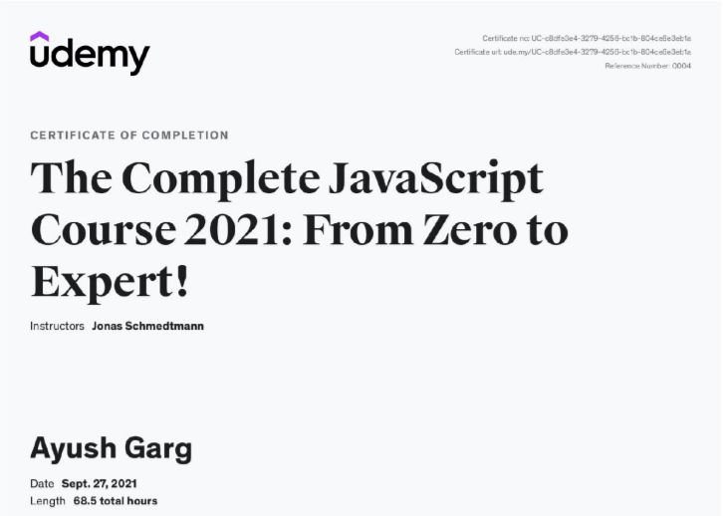
Certificate

Slide 4
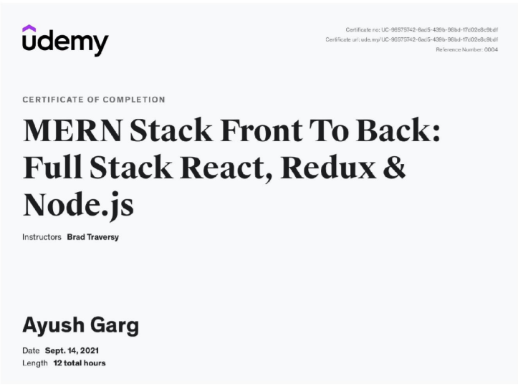
Certificate

Slide 5
TOOLS USED
m
Mongo db
MongoDB is used for database
E
express
Express and Postman is used to make back end development and testing
r
react
React and Redux are used for front end development and state management
N
Node js
Node js is used to add packages to the web application

Slide 6
PURPOSE
Automation of product manipulation
INFORMATION STORAGE
Authentication
Store and manage information of different types of items
Managing security by providing authorized email & password
Inventory is automatically managed
efficiency
design
Request management
Manages database efficiently
Make the UI simpler to navigate and interact with
Express and mongo have been handled efficiently to reduce loading times by 3x times

Slide 7
feasibility
Technical feasibility
Economical feasibility
It is technically feasible, since there will not be much difficulty in getting required resources for the development and maintaining the system as well. All the resources needed for the development of the software as well as the maintenance.
Development of this application is highly economically feasible. The organization needed not spend much more for the development of the system already available. The only thing is to be done is making an environment for the development with an effective supervision. If we are doing so, we can attain the maximum usability of the corresponding resource. Even after the development, the organization will not be in a condition to invest more in the organization. Therefore, the system is economically feasible.

Slide 8
requirement
hardware
software
➢ Processor : Pentium 4 (or equivalent)
➢ RAM : 2 GB RAM
➢ Hard Disk Space : 1 GB
➢ Input Devices : Keyboard, Mouse
➢ Output Devices : Monitor
➢ Connection to the internet
➢ Operating System : Linux, Ubuntu, Mac, Windows XP,7,8,8.1,10
➢ Browser : Latest version of Chrome, Firefox or similar browser
➢ Frontend : React, Redux, Bootstrap
➢ Backend : Express, MongoDB
➢ Node.js version : v16.x.x and above
➢ NPM version : v7.x.x and above

Slide 9
SCREENSHOTS

Slide 10
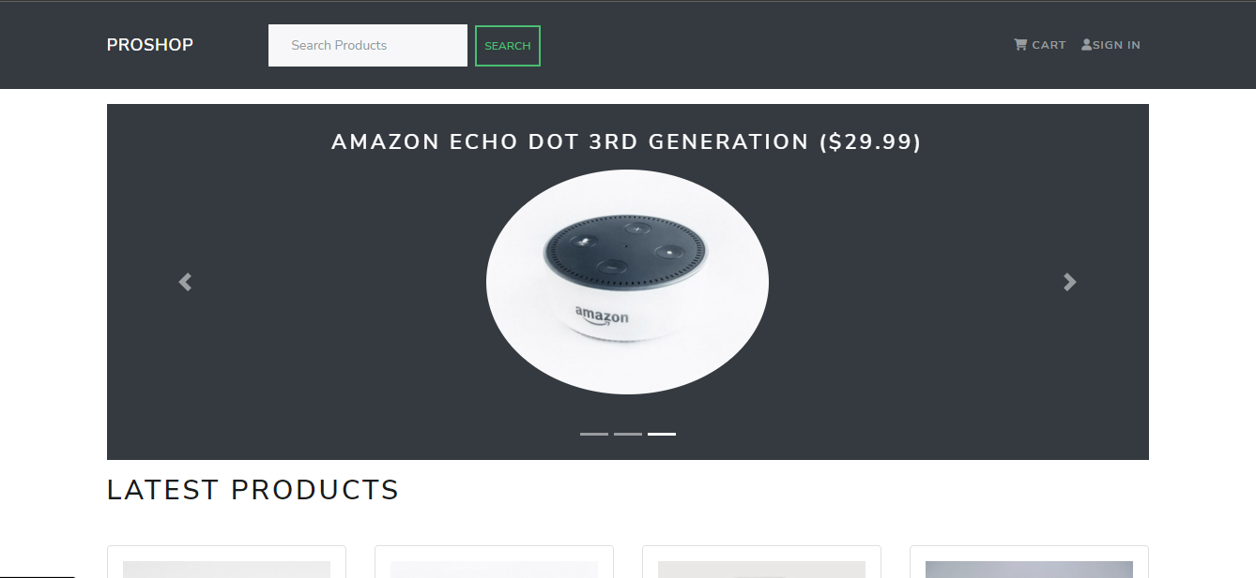
HOMEPAGE

Slide 11
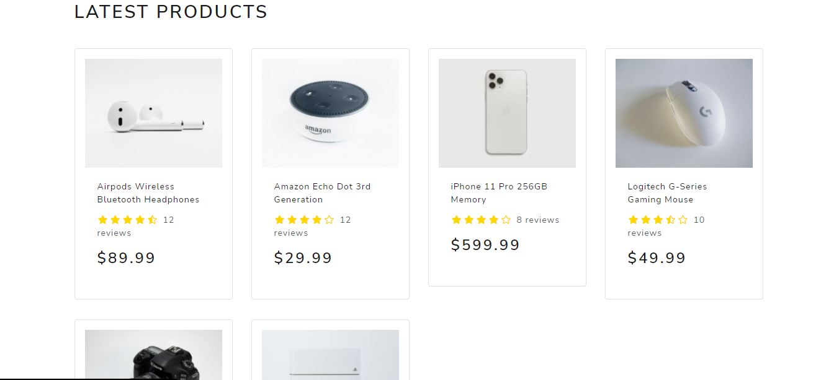
Latest products page

Slide 12
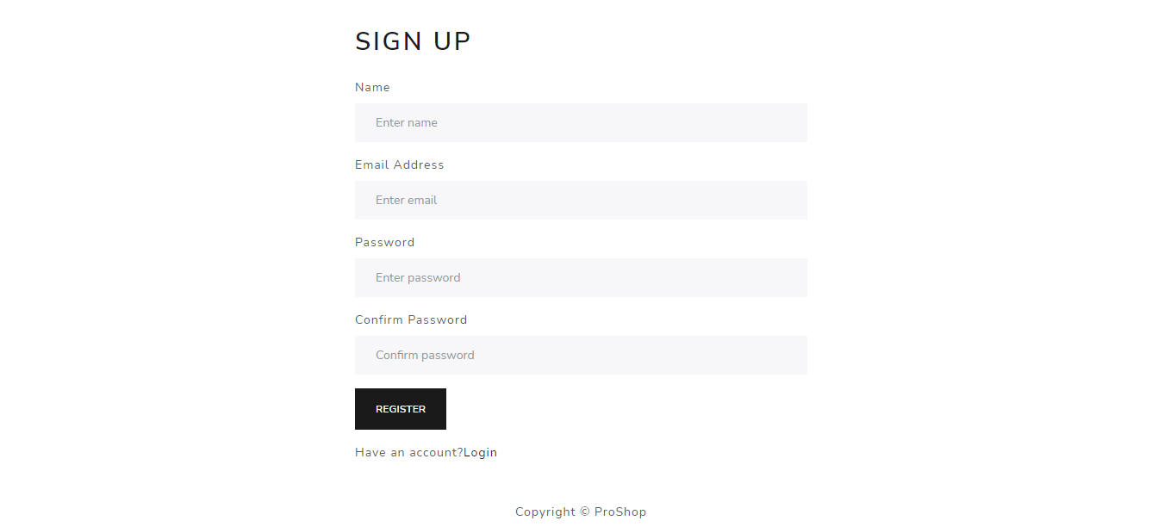
LOGIN / SIGN UP SCREEN

Slide 13
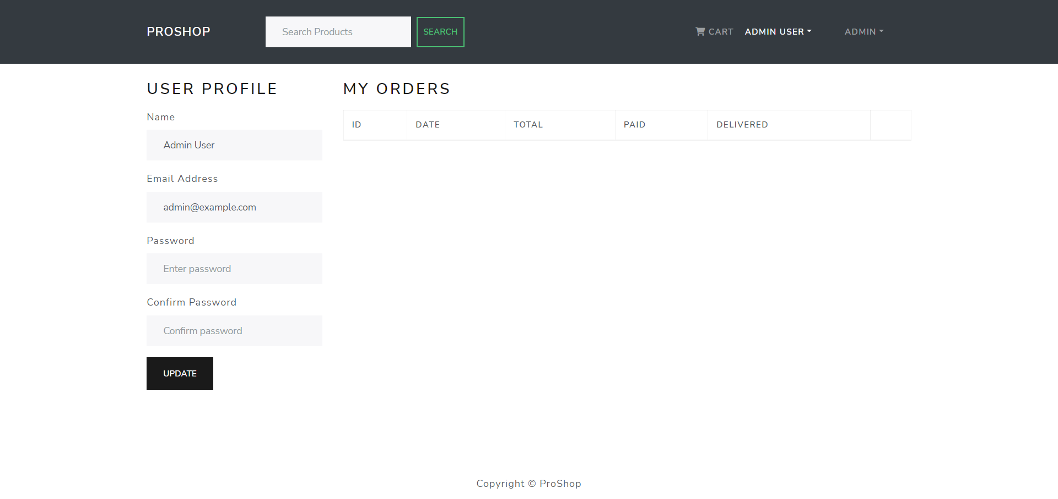
User profile SCREEN

Slide 14
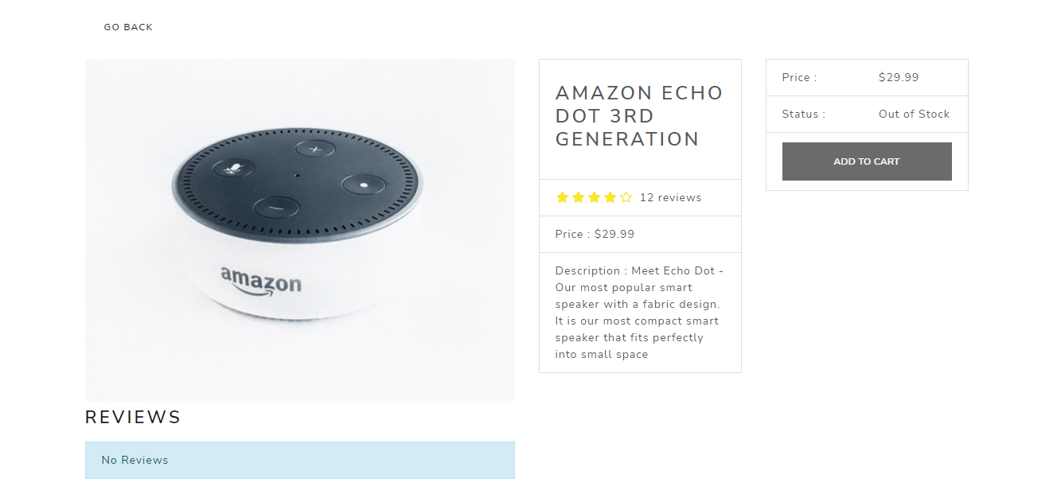
Single product screen

Slide 15
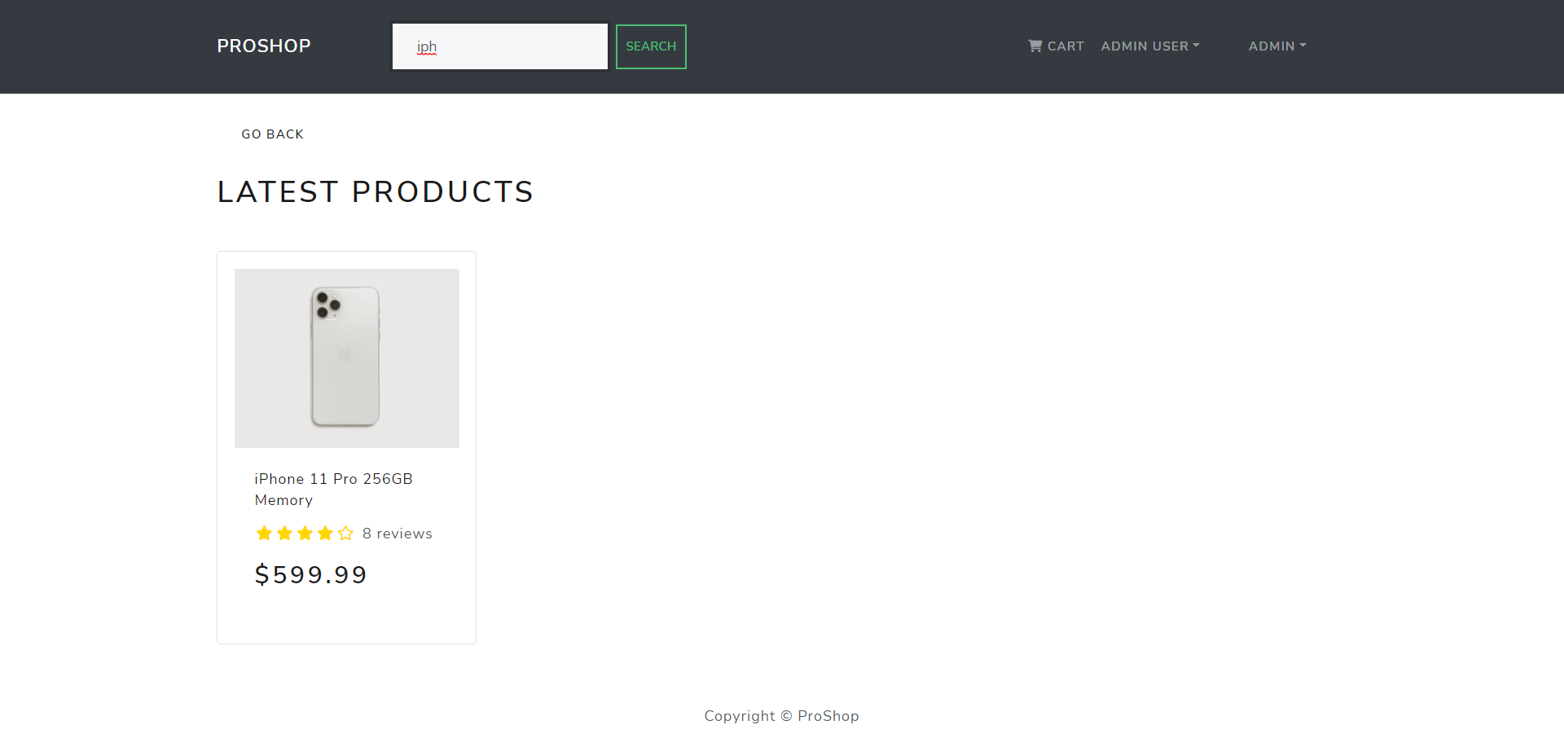
product search screen

Slide 16
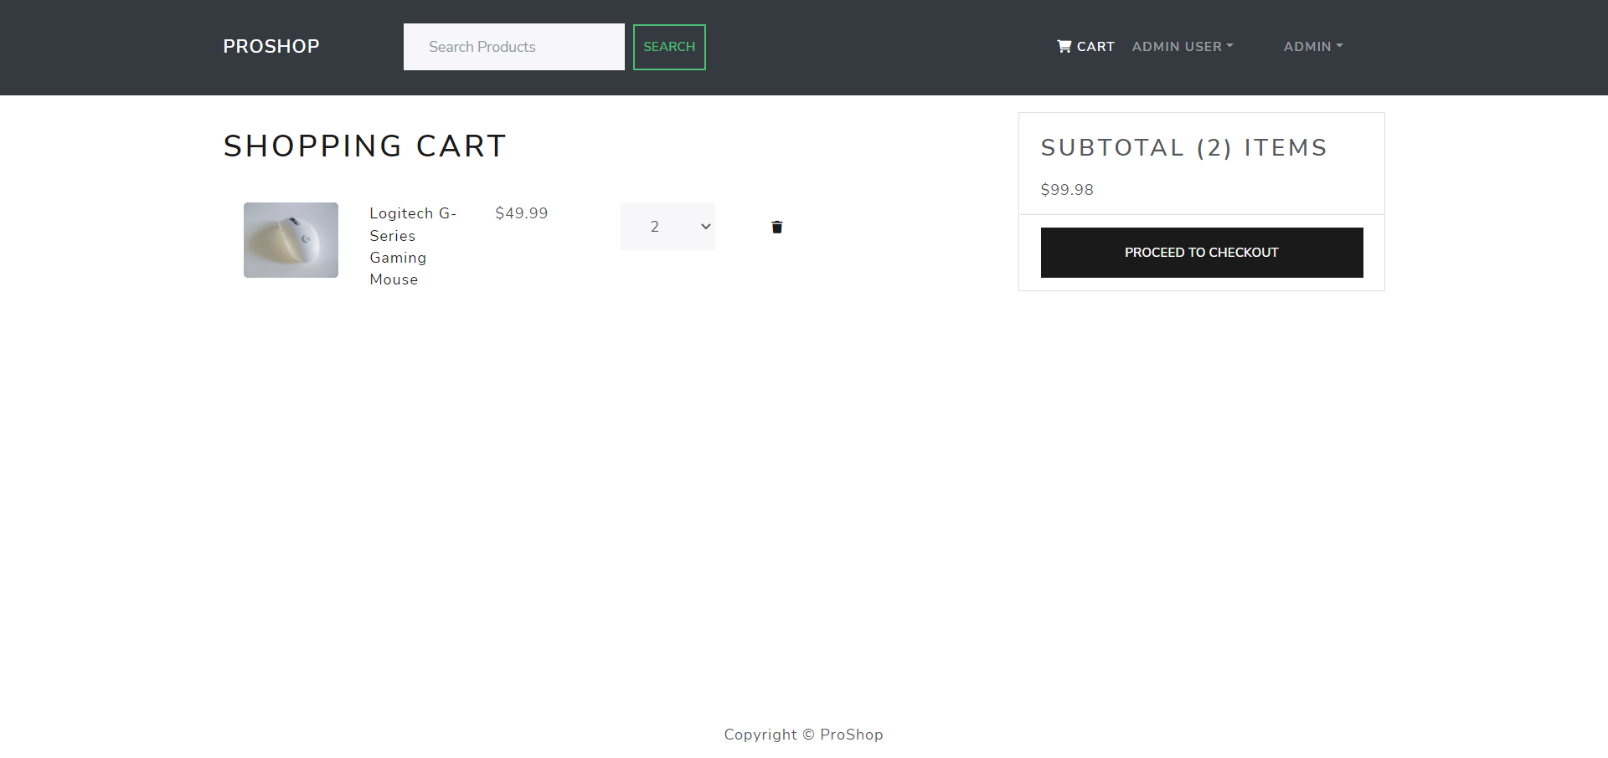
Shopping cart screen

Slide 17
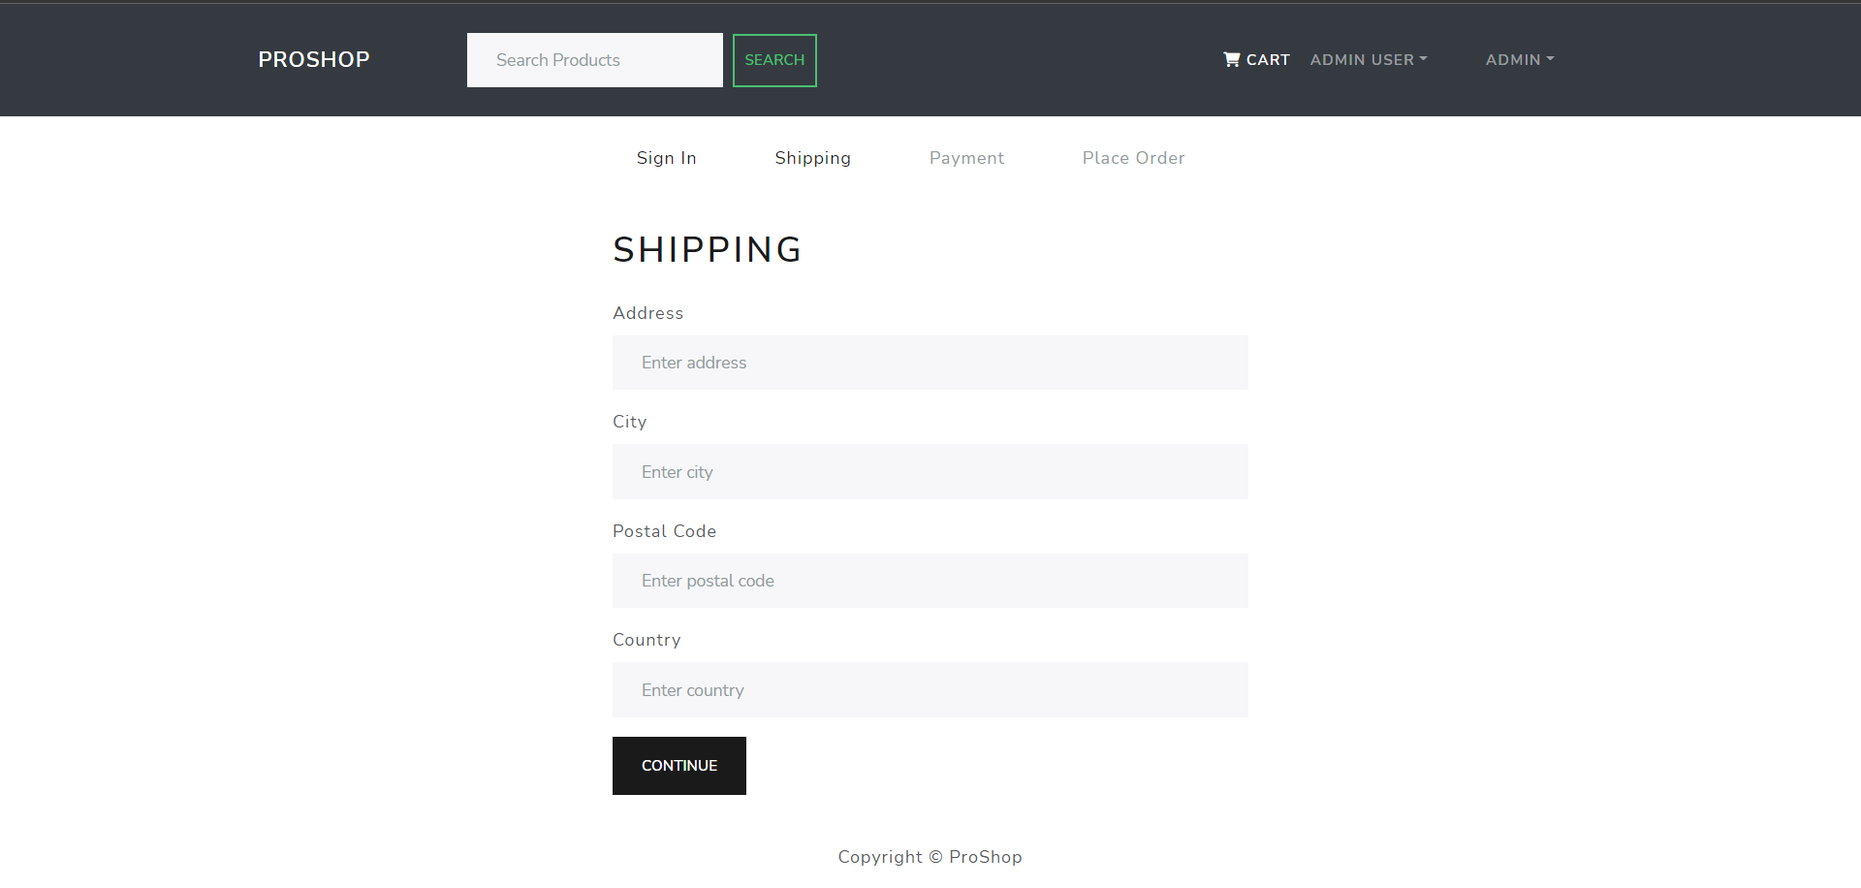
SHIPPING screen

Slide 18
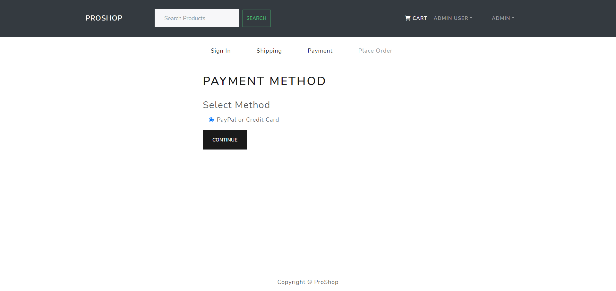
PAYMENT screen

Slide 19
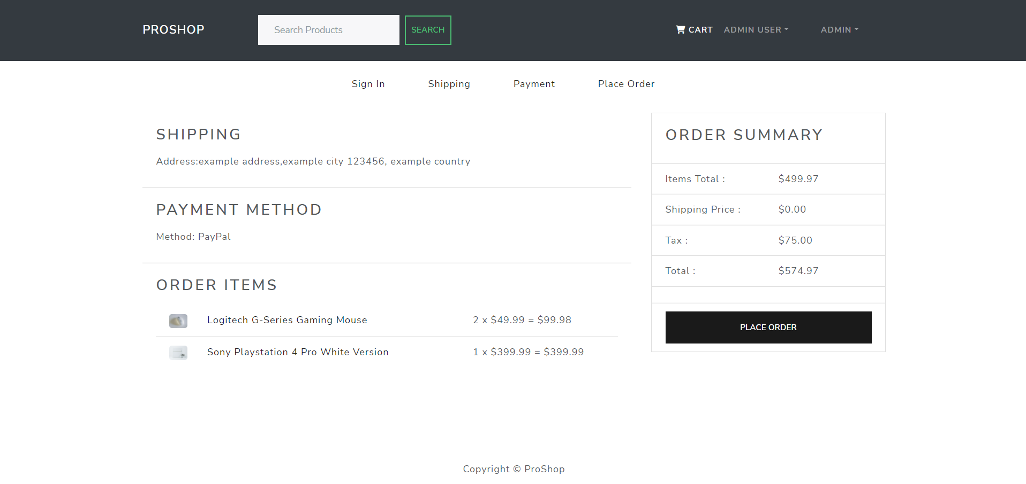
ORDER screen

Slide 20
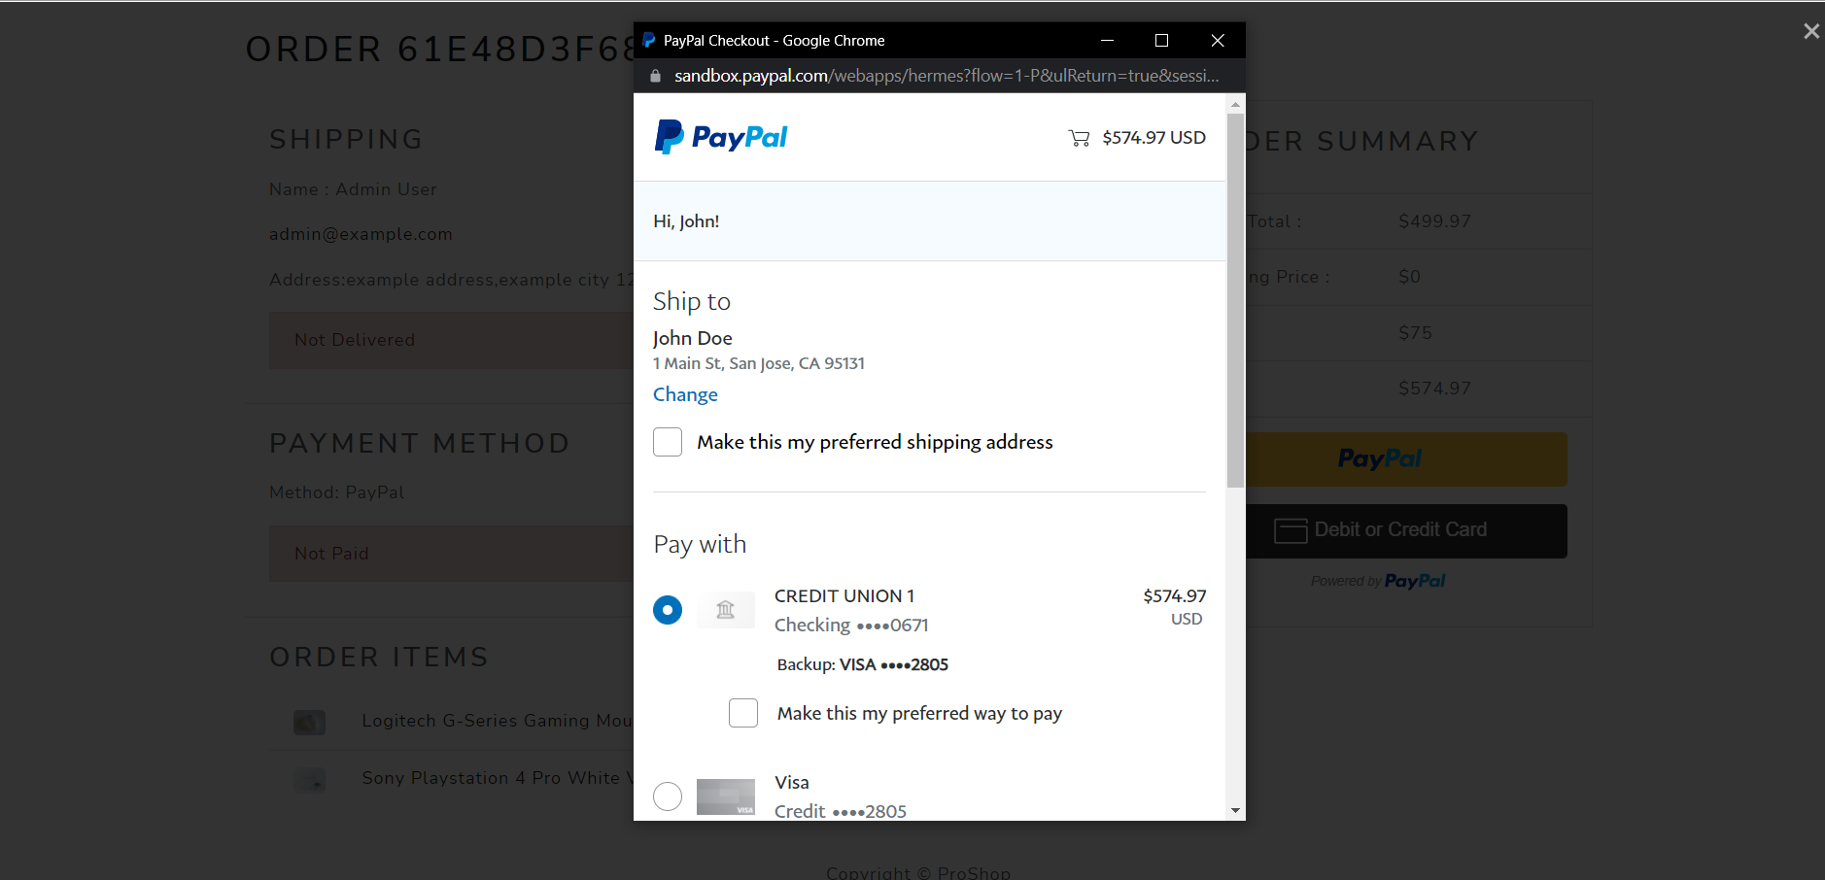
PAYPAL CHECKOUT screen

Slide 21
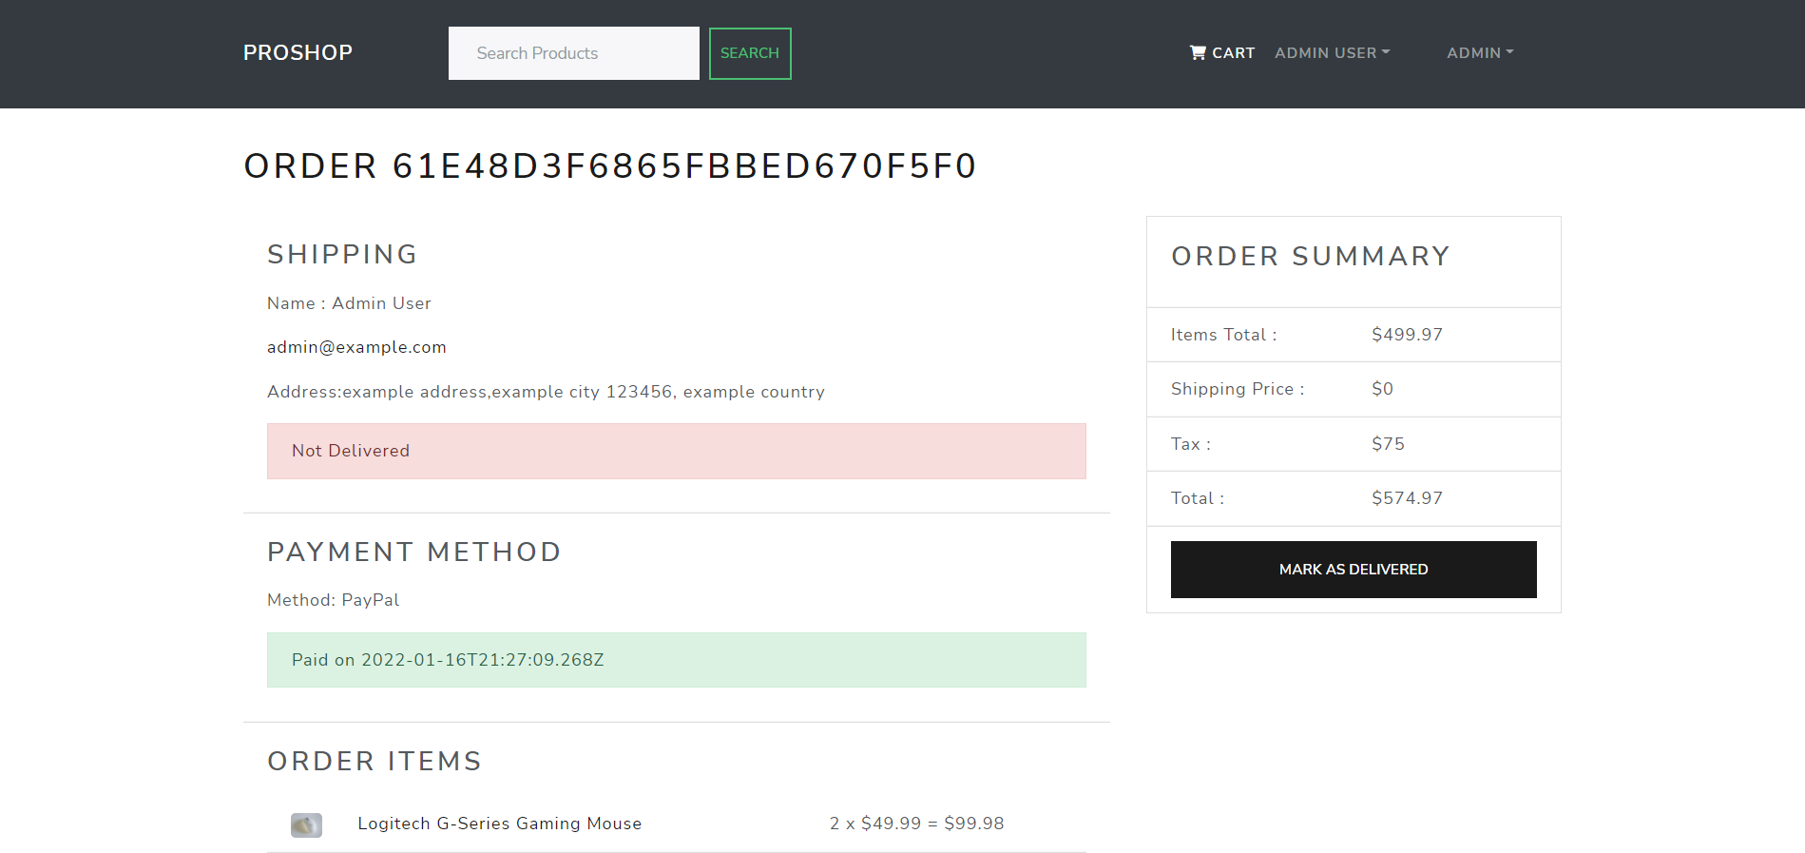
ORDER PLACED screen

Slide 22
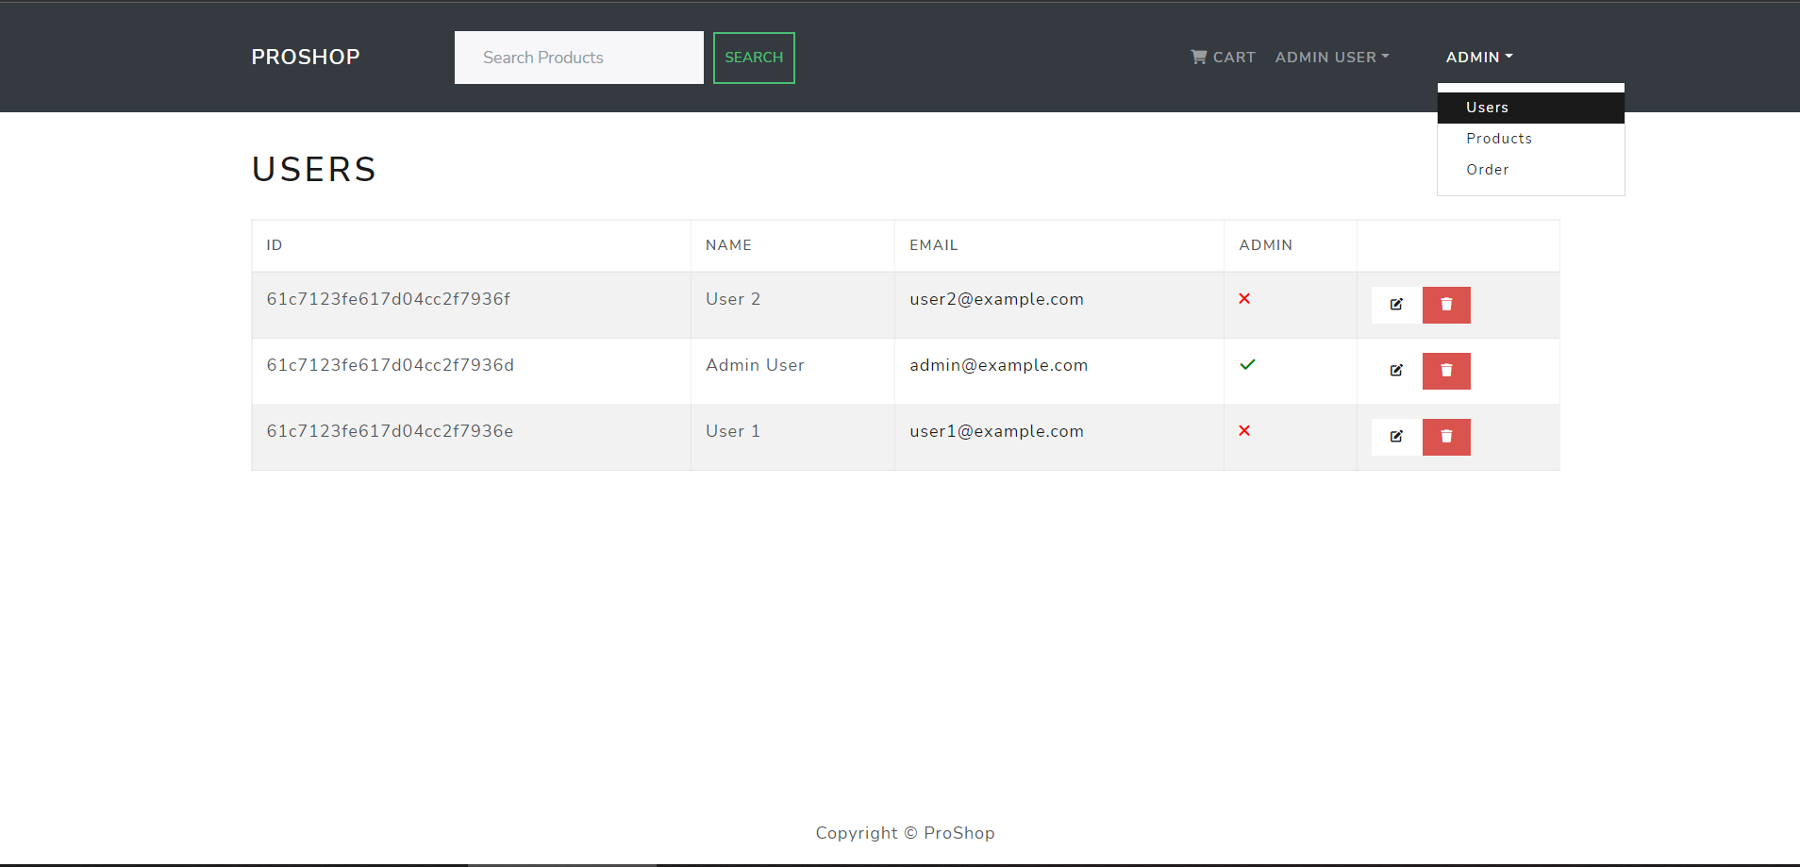
Admin dashboard screen

Slide 23
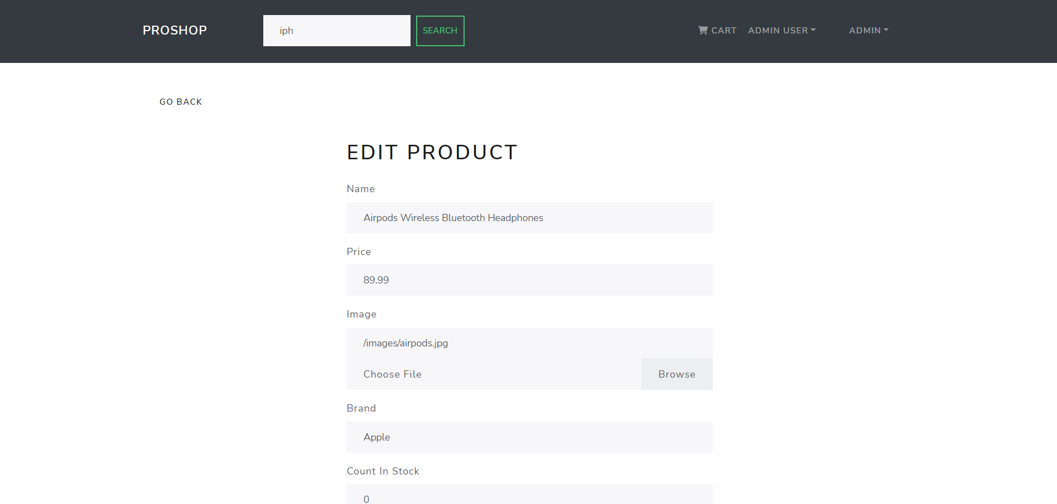
Edit product screen

Slide 24
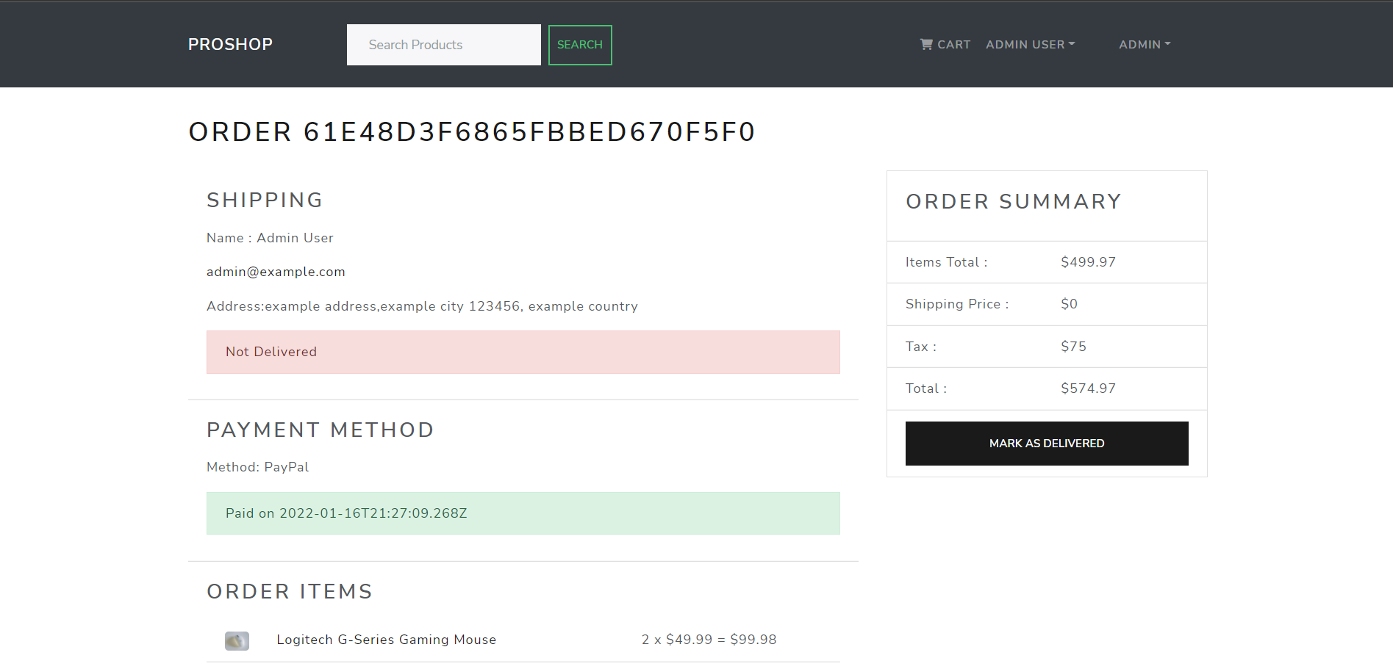
Admin order screen

Slide 25
Future aspects
More payment gateways
Payment methods can be added to increase to attract more users.
Multilingual support
Attract users from various countries and regions.
FILTER products
Filter using brand, category, and price can be added.

Slide 26
conclusion
This website provides a computerized version of shop manipulate system which will benefit the users as well as the visitor of the shop. It makes entire process online where users can search product, and buy various product. It also has a facility for common user by login into the system where user can login and can see status of ordered. It provides the facility of admin’s features where admins can add various item, review users’ and send orders for delivery

Slide 27

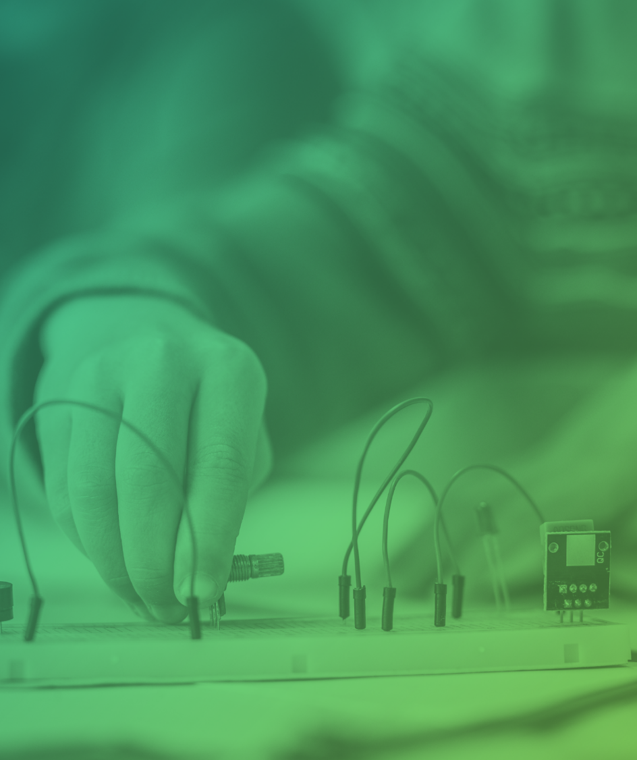
Thank you
Ayush Garg​
13214803119
I – 7
Maharaja Agrasen Institute of Technology

